Slide 1

Data Ethics

Slide 2
Why Data Science?
Quantitative Fields
Math
Probability
Statistics
On-Demand Job Market
LinkedIn Workforce Report: Shortage in All Cities (2018)
Article by Gregory Piatetsky
Applicable Across All Areas
Bigger Data Requires Better Skills
People are Scared Because Analytics is Coming

Slide 3
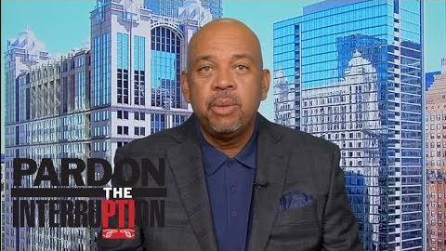

Why Data Science?

Slide 4
Why Data Science?
Data Science is Not a Fad
People Have Data and Need Us to Analyze the Information to Answer Their Questions
Decisions Based on Our Analyses Can Effect Others
We Must Operate Ethically
There is Power in the Information

Slide 5
Some Dope Quotes
With Great Power Comes Great Responsibility.
- Uncle Ben
No One Man Should Have All That Power.
- Kanye West

Slide 6
Hippocratic Oath for Data Scientists
I solemnly pledge to practice my profession with conscience and dignity;
To respect the privacy of the people whose data is confided in me;
To maintain the utmost respect for the individuals whose data I am analyzing;
To be transparent, open, and honest about the type of analysis I am applying to their data;
To never use my knowledge to violate human rights and civil liberties, even under threat.
-- Marie Wallace

Slide 7
Data Fraud
Appropriate Data Analysis
Let the Data Speak for Itself
Hypotheses Before Analyses
Transparency
Data Imputation
Handling of Outliers
Data Transformations
Statistical Methods
Necessary Assumptions
Important Caveats
Variables Included and Excluded

Slide 8

Data Fraud
Recent Incident at Harvard (2018)
Dr. Piero Anversa
31 Publications
Stem Cell Research
Showed the Heart Has the Ability to Regenerate
Fraudulent Data
Article by NY Times

Slide 9
Data Fraud
Thought Provoking Questions
Why Does This Happen?
Are You Capable of This?
How Does This Apply to You in Your Group Projects?

Slide 10
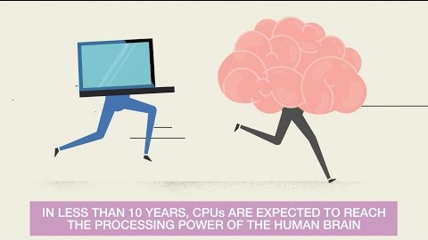
Data is Coming
The Expansion of Data
Thoughts and Concerns?

Slide 11


Data is Coming
How About Now?

Slide 12
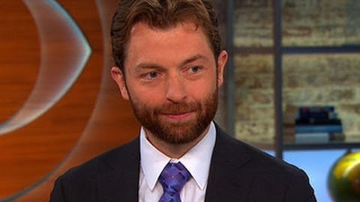
Value of Data
How Much is Data Worth?
In 2016, Microsoft Purchased LinkedIn for $26.2 Billion
In 2016, Caesar’s Total Rewards Program Was Valued at $1 Billion During Bankruptcy
Article in MIT Sloan Magazine

Slide 13
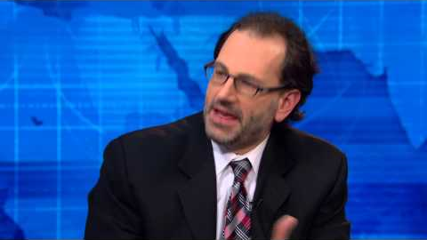
Value of Data
Thought Provoking Questions
Are You Worried About Data Privacy?
How Should We Address This?

Slide 14
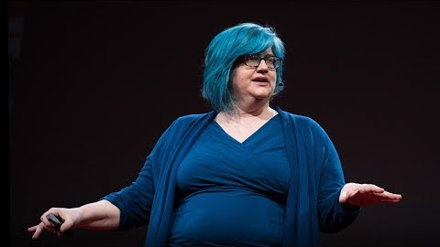
Modern Data Ethics
Weapons of Math Destruction
Author: Cathy O’Neil
Blog: mathbabe.org
Worked on Wall Street
Saw the Dark Side of Using Algorithms on Big Data to Make Business Decisions
Leader in Data Ethics

Slide 15
Closing
Disperse and Make Reasonable Decisions

